Slide 1
Recitation 6

Slide 2
Recitation Schedule
Chapter 1 Review Problems

Slide 3
1.1 #38

Slide 4
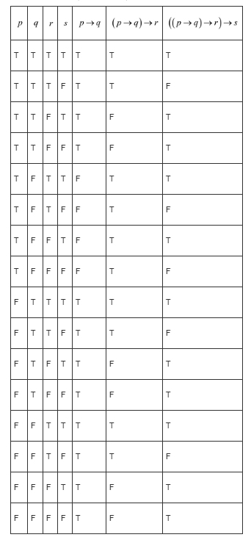
1.1 #38 Answer

Slide 5
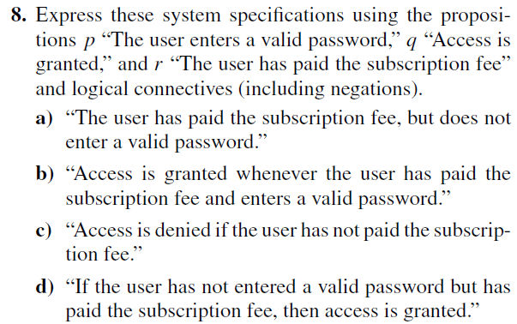
1.2 #8
Notes:
a) r ∧ ¬p
b) r ∧ p → q
c) ¬r → ¬q
d) (¬p ∧ r) → q

Slide 6

1.3 #33
Notes:
To show they are not logically equivalent, we need to find truth values that causes them to be different
To do this, we can either test out different truth values or make a gigantic truth table. Let’s try to logically test out different truth values.
Try to make (p→q)→(r→s) false and make (p→r)→(q→s) true.
Making (p→q)→(r→s) false:
We want (p→q) to be true and (r→s) to be false
If (r→s) is false then that means r is true and s is false
If (p→q) is true then p=q=true or p=q=false or p=false and q=true. Let’s try p=q=false
Test what we assigned p,q,r,s and see if it makes (p→r)→(q→s) true:
p=false, q=false, r=true, s=false
These values make (p→r)→(q→s) true

Slide 7
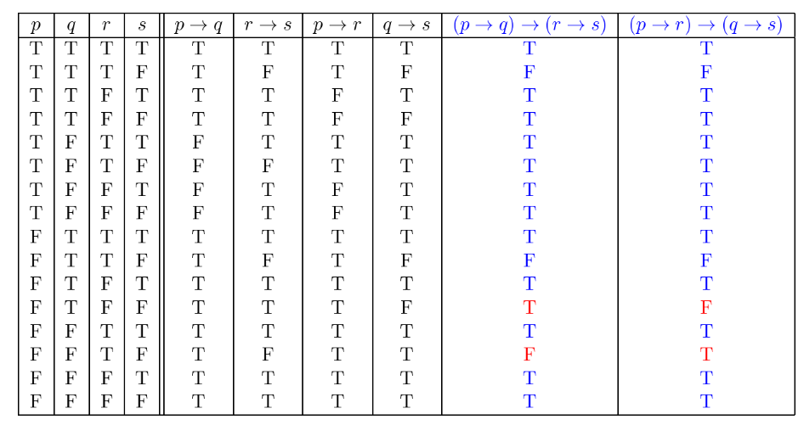
1.3 #33 Answer (truth table if you’re interested)

Slide 8
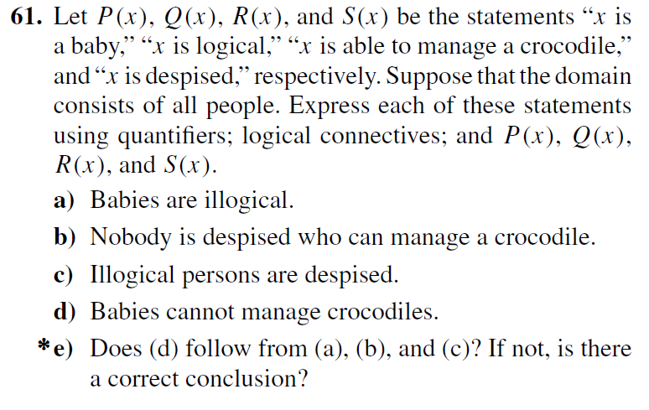
1.4 #61
Notes:
a) for all x(P(x) → ¬Q(x))
b) this phrasing is super shitty lmao so rephrase it as: everybody who can handle a crocodile is not despised.
∀x(R(x) → ¬S(x))
c) ∀x(¬Q(x) → S(x))
d) ∀x(P(x) → R(x))
e) Parts a-c are our premises and d is the conclusion
Babies are illogical so they are despised. P(x) → ¬Q(x) and ¬Q(x) → S(x) thus P(x) → S(x)
And people who handle crocodiles are not despised, thus babies cannot handle crocodiles because they are despised.

Slide 9
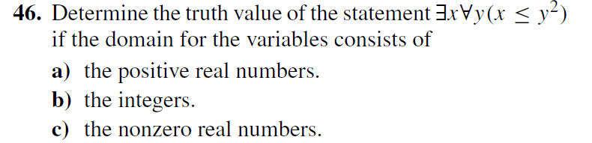
1.5 #46
Notes:
Translate the expression into English.
a) There exists a positive real number x where for all real numbers y, x is less than or equal to y squared.
False.
We have to think of some value where this statement is false.
y = sqrt(x)/2 thus y^2 = x/4
However this means that x <= x/4 which is not true
b) There exists an integer x such that for all real numbers y, x is less than or equal to y squared.
True.
Let x = 0
c) There exists a nonzero real number x such that for all nonzero real numbers y, x is less than or equal to y squared.
True.
Let x = -1
y^2 will always be positive and -1 is less than positive numbers
We can graph x <= y^2 to get a visualization if it’s hard for you to think about.

Slide 10
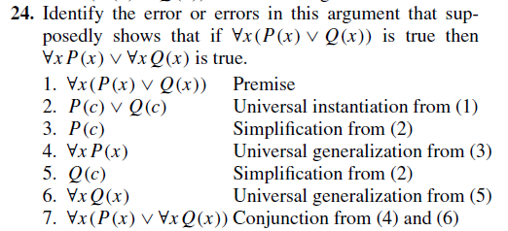
1.6 #24
Notes:
Step 3: Simplification is allowed when you have AND not or
Simplification:
p ∧ q
________
∴ p
Step 7: Conjunction uses the AND symbol not or

Slide 11
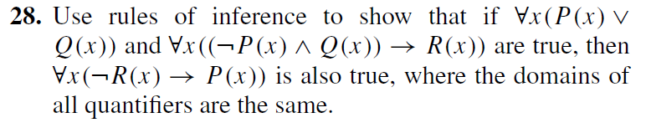
1.6 #28
Notes:
What are we trying to show?
∀x(P(x) ∨ Q(x))
∀x((¬P(x) ∧ Q(x)) → R(x))
_________________________
∴ ∀x(¬R(x) → P(x))
1) Get rid of the universal quantifier using universal instantiation
P(a) ∨ Q(a)
(¬P(a) ∧ Q(a)) → R(a)
_________________________
∴ ∀x(¬R(x) → P(x))
2) Get rid of any implication arrows
P(a) ∨ Q(a)
¬(¬P(a) ∧ Q(a)) ∨ R(a)
_________________________
∴ ∀x(¬R(x) → P(x))
3) Use De Morgan’s Law
P(a) ∨ Q(a)
(P(a) ∨ ¬Q(a)) ∨ R(a)
_________________________
∴ ∀x(¬R(x) → P(x))
4) Use Resolution
Let’s rearrange some of the predicates so it’s easier to see the next move to do
Q(a) ∨ P(a)
(¬Q(a) ∨ P(a)) ∨ R(a)
_________________________
∴ ∀x(¬R(x) → P(x))
P(a)
P(a) ∨ R(a)
_________________________
∴ ∀x(¬R(x) → P(x))
5) Idempotent Law
P(a) ∨ R(a)
_________________________
∴ ∀x(¬R(x) → P(x))
6) We want to turn this into an implication somehow, and we see we also want ¬R(x), so use double negation on R(a)
P(a) ∨ ¬(¬R(a))
_________________________
∴ ∀x(¬R(x) → P(x))
7) Turn into implication
We want to turn this into an implication somehow, and we see we also want ¬R(x), so use double negation on R(a)
¬R(a) → P(a)
_________________________
∴ ∀x(¬R(x) → P(x))
8) Universal generalization
∀x(¬R(x) → P(x))
_________________________
∴ ∀x(¬R(x) → P(x)) Q.E.D

Slide 12

KAHOOT: https://create.kahoot.it/share/rules-of-inference/75d29be2-fa5b-4074-b650-c69d30554afb
FIRST PLACE will get a PEPPA PIG TOOTHBRUSH

